Slide 1
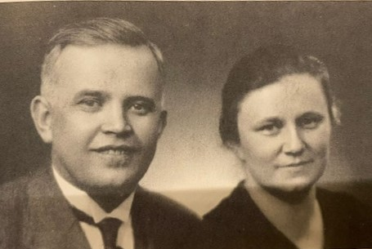

Sanfrid (1895-1976) and Anna-Liisa (1909-1988) Mattsson
Founders of Larsmo Missiohome, Finland
AMBASSADORS OF THE INVISIBLE
Sisko Vierimaa 5.2.2022
(sisko.vierimaa@gmail.com)

Slide 2
FRIENDLY SANFRID, BELOVED BY ALL
- Sandfrid was born in Storforsen (county of Pietarsaari) 23rd of May, 1895. He had seven sisters. He orphaned at the age of 5.
- Influenced by his big brother Sanfrid became Christian and was baptised at the of 17 in 1912
- Sanfrid was drawn to the business world and grew up to be a well-liked merchant, but also partner to God.
- In 1920 Sanfrid built a shop and a home together with a chapel upstairs in Kolppi
- Sanfrid and Mattsson’s brothers: a new church was born - Friförsamlingen i Kållby (Evangelical Free Church of Kolppi)

Slide 3
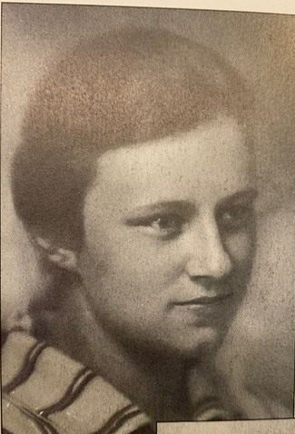
DETERMINED, SKILLED AND TALENTED ANNA-LIISA
Born in Sortavala on the 12th of April 1909 as the first child in the Lindbohm family of believers. Her father worked as a vicar. She had seven sisters. Anna-Liisa orphaned at the age of 10.
- First in her class at the Finnish Girls' School in Mikkeli, her average was 9,6.
- Life's mission becomes clear at the age of 12 :
” I received a missionary call to all those who have not heard about Jesus”
- Received the baptism of the Holy Spirit at home 1st of December 1921
- Mindset learned from home/church: ecumenism
- In the spring of 1928, the Mattsson brothers' wholesaler invites Anna-Liisa from Helsinki to work in Pietarsaari.
Anna-Liisa at the age of 16

Slide 4
THE WINDS OF GOD ARE BLOWING IN THE PIETARSAARI AREA
→ Vicar Heikel's son Viktor Heikel (later professor at the University of Helsinki) had baptized himself by immersion in 1868
- In 1870 the first Baptist church in the country was born in Pietarsaari
- In 1889 Evangelical Free Church was founded in Pietarsaari
- In 1923 the Pentecostal members of the Pietarsaari Baptist church founded the Elim church, where the Mattsson brothers joined.

Slide 5
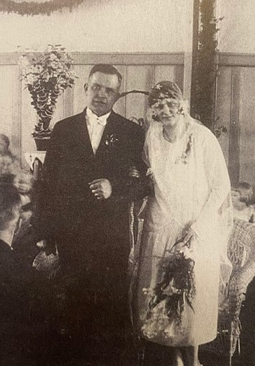
COLLEAGUES SANFRID AND ANNA-LIISA FIND EACH OTHER
THE MISSION FIRE IS LIT
- 34 years old old-boy Sanfrid proposed to 19 years old Anna-Liisa, who had moved from Helsinki to Pietarsaari. The bride was overjoyed and the wedding took place in 1929.
- In the Pentecostal movement, missionary enthusiasm intensified in 1932, when the first missionary course was held in Hanko.
- In the summer of 1935, a large missionary celebration was held in Pietarsaari. The Lord announced in the night prayer to the ambassador of China Toimi Yrjölä that 20 new ambassadors would go to the mission fields the same year.
- The first missionary course in Pietarsaari in 1935

Slide 6
FROM RENT TO OWN: THE LARSMO MISSION HOME IS COMPLETED 1944-45
There was only one evangelical mission school in Finland, which did not accept missionary students from outside the Lutheran Church.
Mission-inspired Mattsons and missionary students volunteer to build an evangelical mission home
Unknown friends of the missionary work, known to the people of the home, brought donations and also food supplies, on which the community lived.
When the house was finished, people were surprised, when Sanfrid informed:
”When construction started, there was not a single mark of money. When it was finished, there was not a mark in debt”.
Witnessing the miracle of God, Larsmo farmers and nearby merchants began to bring their bounty to the house.

Slide 7
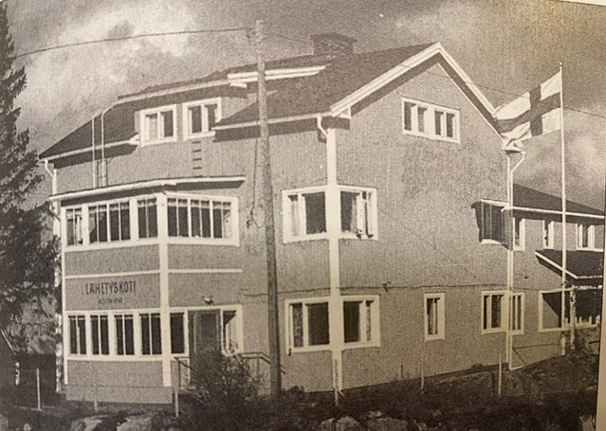
Anna-Liisa’s and Sanfrid’s room
LARSMO MISSIONARY HOME

Slide 8
ABOUT SANFRID’S AND ANNA-LIISA'S TASKS AND WORK IN FINLAND
Sanfrid
Anna-Liisa
The Mattsson brothers' wholesaler, a partner with brother Ernst, gave a large part of its profits to the Lord's work.
Elder brother of Elim church
Administrator in the wholesaler
Guitar choir director, interpreter, language teacher, mission course organiser
- Biblical journal -magazine 1928
- Bible mission, appreciation beyond church boundaries
- Spiritual work for the gypsies
- A new form of evangelism 1935: From Home to Home -work
(in Lapland and Karelia, expanded to 12 countries)
- To every creature – newsletter
(The first published newsletter – Kaikille Luoduille - in Pentecostal movement)
- Prison work
- Children and youth work (children's summer camps, Sunday schools)

Slide 9
MOVING FORWARD IN FAITH
ROLE MODELS
STUDY AND OTHER TRIPS
Hudson Taylor (1858-1905)
A British Protestant Christian missionary to China and founder of the China Inland Mission
Charles and Lettie Cowman (1870-1960)
Home mission in the Far East, the Gospel to 10 million homes, 1200 mission stations
C.T. Studd (1860-1931)
Wealthy, donated his fortune to the Lord, worked in India, Africa, etc.
By cargo ship to England 1936
Svansea Mission School and meeting with the Ethiopian Emperor
Trips in America
Altogether six trips in 1947-1986
The aim was to build relationships with other friends of missionary, promote the work of Larsmo and Ethiopia and raise funds to spread the gospel in different countries.

Slide 10
THE LORD BLESSES THE WORK HE HAS BEGUN, A FEW EXAMPLES
In 1941-1945 Mattssons printed and distributed two million gospels. 700.000 of these were in Russian.
A trip to America in 1947-1948 resulted in the gift of 800,000 gospels for missionary work in China
In 1936-1939 Mattssons personally distributed 600,000 Gospels to soldiers and prisoners in prison camps in the Baltic countries (25 different prisons)
In 1936-1939, a total of 600,000 gospels were delivered to the evangelists of Eastern European countries (Estonia, Latvia, Lithuania and Poland) from the Larsmo Mission Home.

Slide 11
TO EVERY CREATURE – FOUNDATION (KAIKILLE LUODUILLE) 1951
On 19th April 1951, the Foundation To Every Creature was established, to which the Mattssons donated the Larsmo Mission Home they owned by deed of gift.
The purpose of the foundation was, according to the biblical doctrine, to serve the work of inward and outward mission.
All the activities of the foundation were carried out with voluntary, unpaid labour. The foundation did not incur any debt to expand its work.

Slide 12
THE LORD LEADS THE WAY TO WORK IN ETHIOPIA
Trip to Ethiopia starts 8th August 51
The first Finnish missionaries in Ethiopia, a very poor country
A wide international circle of friends
The meeting with the Ethiopian Emperor 26th October 1951
→ presentation of the work plan to the Emperor
Missionary station Wolmara 1955
- The emperor rents 80 hectares of land
Health clinic, school, chapel, granary and residential buildings
The right to do missionary work on the farm, but also to teach young people, at no cost, about farming, gardening, crafts, etc.
Work Center in Addis Abeba 1956
Mattssons' work in Ethiopia lasts 25 years

Slide 13
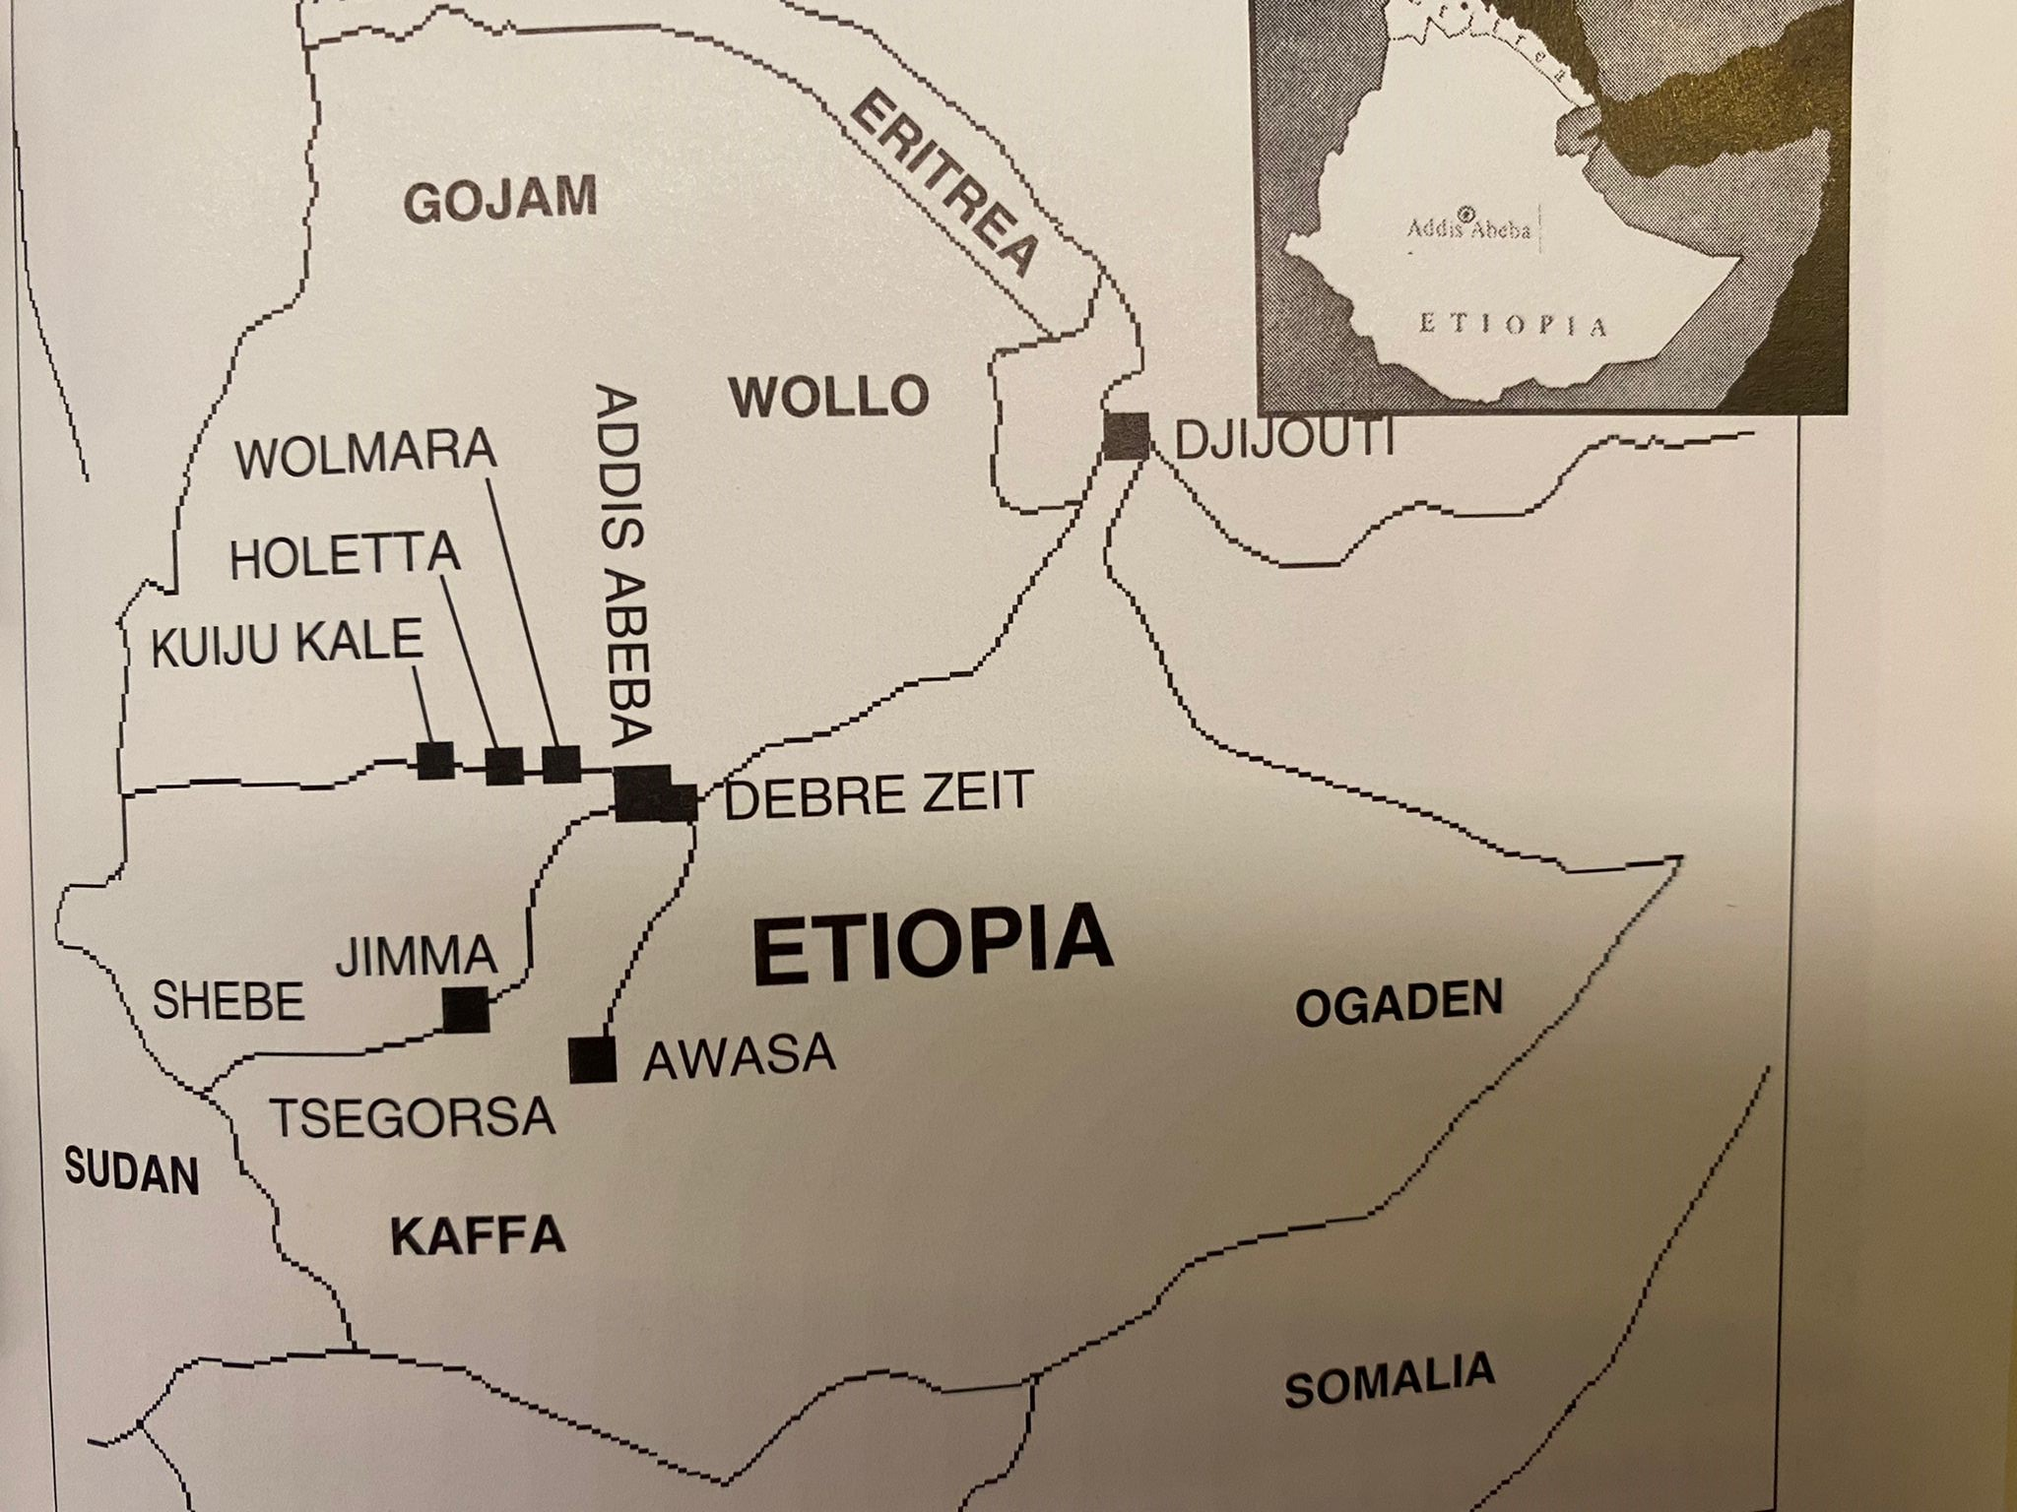
The working sites of To every creature (Kaikille Luoduille) –foundation:
Addis Abeba, Wolmara, Holetta, Kuiju Kale, Jimma, Awasa, Djijouti, Debre Zeit

Slide 14
SANFRID’S AND ANNA-LIISA'S JOURNEY ON EARTH ENDS, BUT THE WORK CONTINUES
Sanfrid’s life ends with a massive heart attack on 17 July 1976 at Filouha Hospital in Ethiopia at the age of 81
Anna-Liisa dies in a Moscow hospital at the age of 79 on 15th June 1988
The mission station (2021 = multi-purpose centre) and its buildings in the village of Wolmara, founded by the Mattssons, have been in the hands of the authorities for years. In February 2021, the site was ceremoniously handed back to the local church community. The ceremony commemorated the Mattssons' huge contribution to Ethiopia.
Church Plan 2021: 500 evangelists will be sent over the next five years, with the aim of planting 500 churches and reaching 5 million people.

Slide 15
THE HERITAGE OF MISSIONARY HOME AND FORMS OF WORK 2022
Kaikille Luoduille ry (To every creature) sells the site to Pentecostal churches of Pietarsaari and Kokkola in 2004.
The Pentecostal church of Kokkola will redeem all the shares in Pietarsaari in 2012 (the money for the purchase was miraculously found, as well as the money for the major renovations of the building).
Forms of work: Children and youth camps, migrant, refugee and Jewish camps, discipleship camps, various family activities and facility rental, prayer week 3-4 times a year starting in 2021.
→ The work is still done as it was in the Mattssons' time, i.e. with voluntary work and various donations.

Slide 16
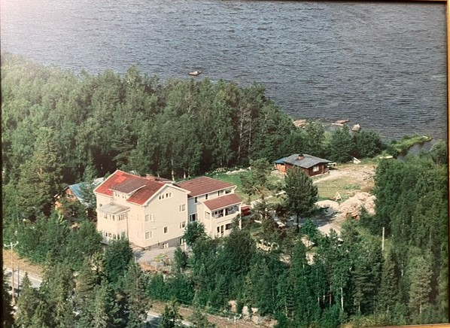
Thank you ☺
skdfjö Translation from Finnish to English: Sirpa Saastamoinen

